Slide 1
GREEDY TECHNIQUES
Fractional Knapsack
Huffman Coding

Slide 2
In greedy approach, the decision is taken on the basis of current available information without worrying about the effect of the current decision in future.
Greedy algorithms build a solution part by part, choosing the next part in such a way, that it gives an immediate benefit.
This approach never reconsiders the choices taken previously.
This approach is mainly used to solve optimization problems.
Greedy method is easy to implement and quite efficient in most of the cases.
Hence, we can say that Greedy algorithm is an algorithmic paradigm based on heuristic that follows local optimal choice at each step with the hope of finding global optimal solution.

Slide 3
In many problems, it does not produce an optimal solution though it gives an approximate (near optimal) solution in a reasonable time.
Greedy Method finds out of many options, but you have to choose the best option."
In this method, we have to find out the best method/option out of many present ways.
In this approach/method we focus on the first stage and decide the output, don't think about the future.
This method may or may not give the best output.

Slide 4
Greedy Algorithm solves problems by making the best choice that seems best at the particular moment.
Many optimization problems can be determined using a greedy algorithm.
Some issues have no efficient solution, but a greedy algorithm may provide a solution that is close to optimal.
A greedy algorithm works if a problem exhibits the following two properties:
Greedy Choice Property: A globally optimal solution can be reached at by creating a locally optimal solution. In other words, an optimal solution can be obtained by creating "greedy" choices.
Optimal substructure: Optimal solutions contain optimal sub solutions. In other words, answers to sub problems of an optimal solution are optimal

Slide 5
Example:
machine scheduling
Fractional Knapsack Problem
Minimum Spanning Tree
Huffman Code
Job Sequencing
Activity Selection Problem

Slide 6
Steps for achieving a Greedy Algorithm are:
Feasible: Here we check whether it satisfies all possible constraints or not, to obtain at least one solution to our problems.
Local Optimal Choice: In this, the choice should be the optimum which is selected from the currently available
Unalterable: Once the decision is made, at any subsequence step that option is not altered.

Slide 7
Problem Statement
A thief is robbing a store and can carry a maximal weight of W into his knapsack. There are n items available in the store and weight of i^{th} item is w_{i} and its profit is p_{i}. What items should the thief take?
In this context, the items should be selected in such a way that the thief will carry those items for which he will gain maximum profit. Hence, the objective of the thief is to maximize the profit.
Based on the nature of the items, Knapsack problems are categorized as
Fractional Knapsack
Knapsack

Slide 8
Fractional Knapsack
In this case, items can be broken into smaller pieces, hence the thief can select fractions of items.
According to the problem statement,
There are n items in the store
Weight of ith item wi>0
Profit for ith item pi>0 and
Capacity of the Knapsack is W
In this version of Knapsack problem, items can be broken into smaller pieces. So, the thief may take only a fraction x_{i} of i^{th} item.
0⩽xi⩽1
The i^{th} item contributes the weight x_{i}.w_{i} to the total weight in the knapsack and profit xi.pi to the total profit.

Slide 9
Example
Let us consider that the capacity of the knapsack W = 60 and the list of provided items are shown in the following table −
Item | A | B | C | D
Profit | 280 | 100 | 120 | 120
Weight | 40 | 10 | 20 | 24
Ratio (pi/wi) | 7 | 10 | 6 | 5

Slide 10
As the provided items are not sorted based on (pi/wi). After sorting, the items are as shown in the following table
Item | B | A | C | D
Profit | 100 | 280 | 120 | 120
Weight | 10 | 40 | 20 | 24
Ratio (pi/wi) | 10 | 7 | 6 | 5

Slide 11
Solution
After sorting all the items according to pi/wi. First all of B is chosen as weight of B is less than the capacity of the knapsack. Next, item A is chosen, as the available capacity of the knapsack is greater than the weight of A. Now, C is chosen as the next item. However, the whole item cannot be chosen as the remaining capacity of the knapsack is less than the weight of C.
Hence, fraction of C (i.e. (60 − 50)/20) is chosen.
Now, the capacity of the Knapsack is equal to the selected items. Hence, no more item can be selected.
The total weight of the selected items is 10 + 40 + 20 * (10/20) = 60
And the total profit is 100 + 280 + 120 * (10/20) = 380 + 60 = 440
This is the optimal solution. We cannot gain more profit selecting
any different combination of items.

Slide 12
Algorithm
Algorithm: Greedy-Fractional-Knapsack (w[1..n], p[1..n], W)
for i = 1 to n
do x[i] = 0
weight = 0
for i = 1 to n
if weight + w[i] ≤ W then
x[i] = 1
weight = weight + w[i]
else
x[i] = (W - weight) / w[i] //fraction
weight = W
break
return x

Slide 13
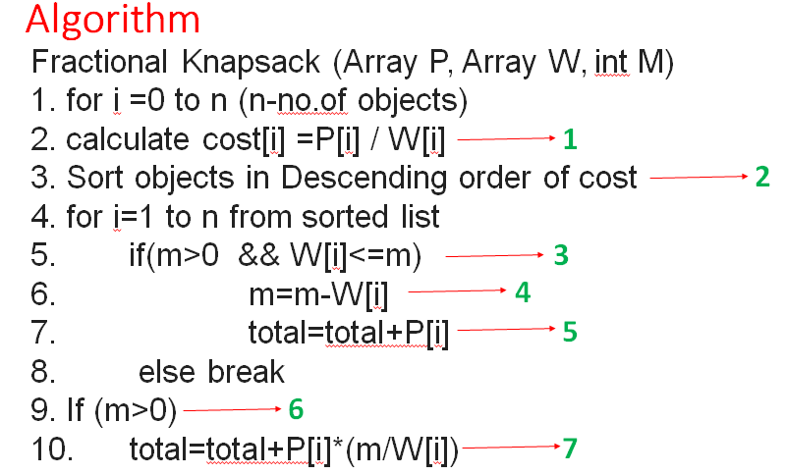
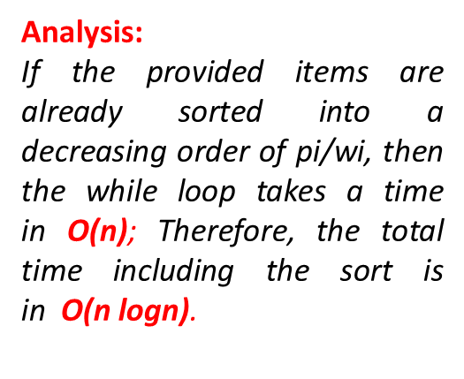
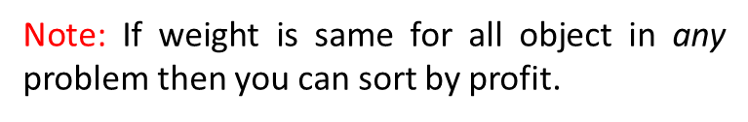

Slide 14
EXAMPLE-2
M= 15 N=5
OBJECT | 1 | 2 | 3 | 4 | 5
PROFIT | 2 | 28 | 25 | 18 | 9
WEIGHT | 1 | 4 | 5 | 3 | 3

Slide 15
EXAMPLE-3
M= 15 N=7
OBJECT | 1 | 2 | 3 | 4 | 5 | 6 | 7
PROFIT | 10 | 5 | 15 | 7 | 6 | 18 | 3
WEIGHT | 2 | 3 | 5 | 7 | 1 | 4 | 1
COST(p/w) | 5 | 1.6 | 3 | 1 | 6 | 4.5 | 3

Slide 16
EXAMPLE-3
M= 15 N=7
OBJECT | 1 | 2 | 3 | 4 | 5 | 6 | 7
PROFIT | 6 | 10 | 18 | 15 | 3 | 5 | 7
WEIGHT | 1 | 2 | 4 | 5 | 1 | 3 | 7
COST(p/w) | 6 | 5 | 4.5 | 3 | 3 | 1.6 | 1

Slide 17
Huffman code

Slide 18
Huffman code
Huffman coding is a lossless data compression algorithm.
The idea is to assign variable-length codes to input characters, lengths of the assigned codes are based on the frequencies of corresponding characters.
The most frequent character gets the smallest code and the least frequent character gets the largest code.
The variable-length codes assigned to input characters are Prefix Codes, means the codes (bit sequences) are assigned in such a way that the code assigned to one character is not the prefix of code assigned to any other character.
This is how Huffman Coding makes sure that there is no ambiguity when decoding the generated bitstream.

Slide 19
Let us understand prefix codes with a counter example.
Let there be four characters a, b, c and d, and their corresponding variable length codes be 00, 01, 0 and 1.
This coding leads to ambiguity because code assigned to c is the prefix of codes assigned to a and b.
If the compressed bit stream is 0001, the de-compressed output may be “cccd” or “ccb” or “acd” or “ab”.
There are mainly two major parts in Huffman Coding
Build a Huffman Tree from input characters.
Traverse the Huffman Tree and assign codes to characters.

Slide 20
Steps to build Huffman Tree
Input is an array of unique characters along with their frequency of occurrences and output is Huffman Tree.
Create a leaf node for each unique character and build a min heap of all leaf nodes (Min Heap is used as a priority queue. The value of frequency field is used to compare two nodes in min heap. Initially, the least frequent character is at root)
Extract two nodes with the minimum frequency from the min heap.
Create a new internal node with a frequency equal to the sum of the two nodes frequencies. Make the first extracted node as its left child and the other extracted node as its right child. Add this node to the min heap.
Repeat steps#2 and #3 until the heap contains only one node. The remaining node is the root node and the tree is complete.

Slide 21
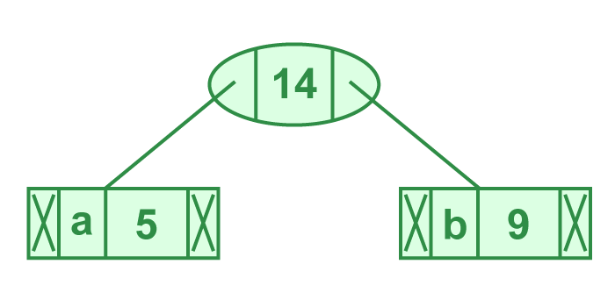
Let us understand the algorithm with an example:
character Frequency
a 5
b 9
c 12
d 13
e 16
f 45
Step 1. Build a min heap that contains 6 nodes where each node represents root of a tree with single node. Step 2 Extract two minimum frequency nodes from min heap. Add a new internal node with frequency 5 + 9 = 14.

Slide 22
Now min heap contains 5 nodes where 4 nodes are roots of trees with single element each, and one heap node is root of tree with 3 elements
character Frequency
c 12
d 13
Internal Node 14
e 16
f 45
Notes:
character Frequency c 12 d 13 Internal Node 14 e 16 f 45

Slide 23
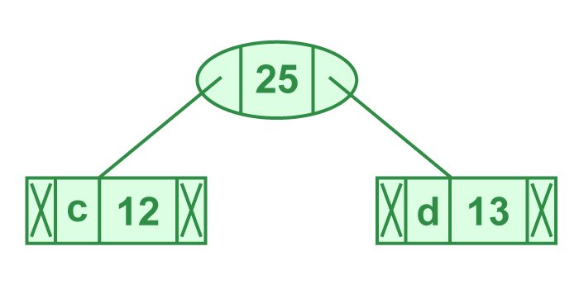
Step 3: Extract two minimum frequency nodes from heap. Add a new internal node with frequency 12 + 13 = 25
Now min heap contains 4 nodes where 2 nodes are roots of trees with single element each, and two heap nodes are root of tree with more than one nodes
character Frequency
Internal Node 14
e 16
Internal Node 25
f 45

Slide 24
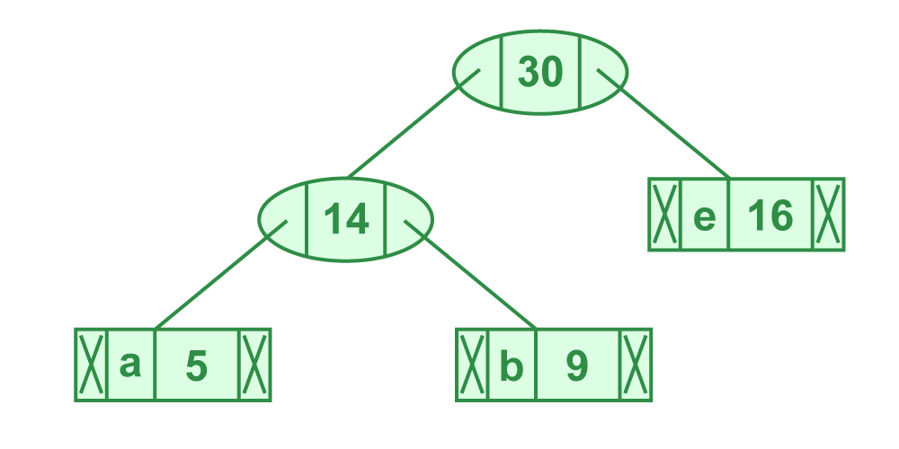
Step 4: Extract two minimum frequency nodes. Add a new internal node with frequency 14 + 16 = 30
Now min heap contains 3 nodes.
character Frequency
Internal Node 25
Internal Node 30
f 45

Slide 25
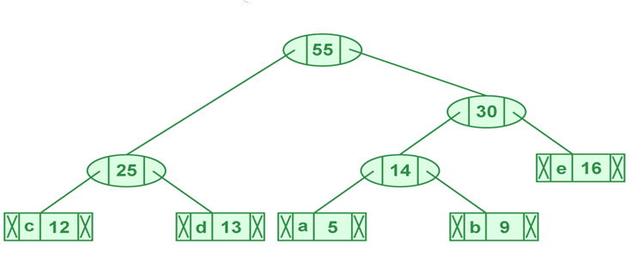
Step 5: Extract two minimum frequency nodes. Add a new internal node with frequency 25 + 30 = 55
Now min heap contains 2 nodes.
character Frequency
f 45
Internal Node 55

Slide 26
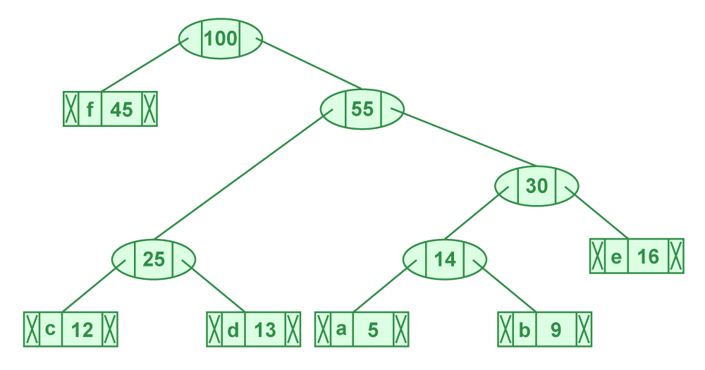
Step 6: Extract two minimum frequency nodes. Add a new internal node with frequency 45 + 55 = 100
Now min heap contains only one node.
character Frequency
Internal Node 100
Since the heap contains only one node, the algorithm stops here.

Slide 27
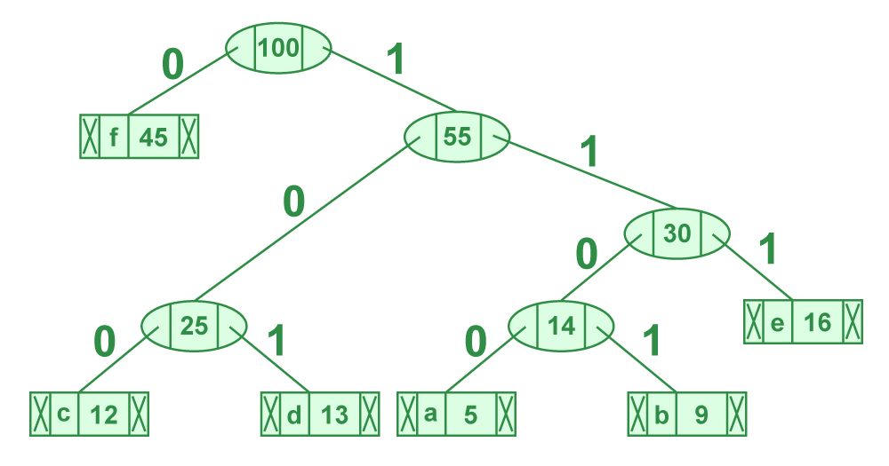
Steps to print codes from Huffman Tree: Traverse the tree formed starting from the root. Maintain an auxiliary array. While moving to the left child, write 0 to the array. While moving to the right child, write 1 to the array. Print the array when a leaf node is encountered.

Slide 28
The codes are as follows:
character code-word
f 0
c 100
d 101
a 1100
b 1101
e 111

Slide 29


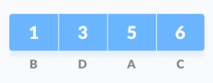
Example 2:
Suppose the string given below is to be sent over a network
Huffman coding is done with the help of the following steps.
1. Calculate the frequency of each character in the string
2. Sort the characters in increasing order of the frequency. These are stored in a priority queue Q.

Slide 30
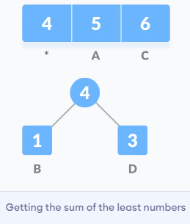
3. Make each unique character as a leaf node.
4. Create an empty node z. Assign the minimum frequency to the left child of z and assign the second minimum frequency to the right child of z. Set the value of the z as the sum of the above two minimum frequencies.
5. Remove these two minimum frequencies from Q and add the sum into the list of frequencies (* denote the internal nodes in the figure above).
6. Insert node z into the tree.
7. Repeat steps 3 to 5 for all the characters.

Slide 31
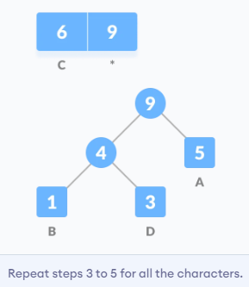
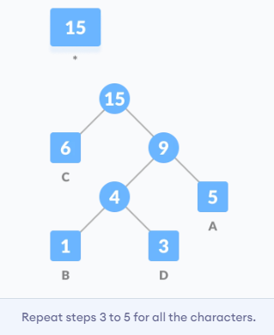

Slide 32
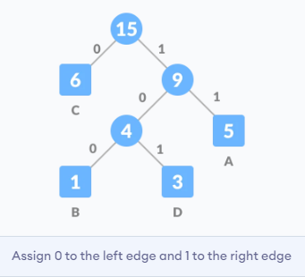
8. For each non-leaf node, assign 0 to the left edge and 1 to the right edge.

Slide 33
Huffman Coding Algorithm:
create a priority queue Q consisting of each unique character.
sort then in ascending order of their frequencies.
for all the unique characters:
create a newNode
extract minimum value from Q and assign it to leftChild of newNode
extract minimum value from Q and assign it to rightChild of newNode
calculate the sum of these two minimum values and assign it to the
value of newNode
insert this newNode into the tree
return rootNode

Slide 34
Time complexity: O(nlogn) where n is the number of unique characters. If there are n nodes, extractMin() is called 2*(n – 1) times. extractMin() takes O(logn) time as it calls minHeapify(). So, overall complexity is O(nlogn).
If the input array is sorted, there exists a linear time algorithm. We will soon be discussing in our next post.
Applications of Huffman Coding:
They are used for transmitting fax and text.
They are used by conventional compression formats like PKZIP, GZIP, etc.
Multimedia codecs like JPEG, PNG, and MP3 use Huffman encoding(to be more precise the prefix codes).
It is useful in cases where there is a series of frequently occurring characters.

Slide 35
// Create nodes
struct MinHNode *newNode(char item, unsigned freq) {
struct MinHNode *temp = (struct MinHNode *)malloc(sizeof(struct MinHNode));
temp->left = temp->right = NULL;
temp->item = item;
temp->freq = freq;
return temp;
}
// Create min heap
struct MinHeap *createMinH(unsigned capacity) {
struct MinHeap *minHeap = (struct MinHeap *)malloc(sizeof(struct MinHeap));
minHeap->size = 0;
minHeap->capacity = capacity;
minHeap->array = (struct MinHNode **)malloc(minHeap->capacity * sizeof(struct MinHNode *));
return minHeap;
}
// Huffman Coding in C
#include <stdio.h>
#include <stdlib.h>
#define MAX_TREE_HT 50
struct MinHNode {
char item;
unsigned freq;
struct MinHNode *left, *right;
};
struct MinHeap {
unsigned size;
unsigned capacity;
struct MinHNode **array;
};

Slide 36
// Function to swap
void swapMinHNode(struct MinHNode **a, struct MinHNode **b) {
struct MinHNode *t = *a;
*a = *b;
*b = t;
}
// Heapify
void minHeapify(struct MinHeap *minHeap, int idx) {
int smallest = idx;
int left = 2 * idx + 1;
int right = 2 * idx + 2;
if (left < minHeap->size && minHeap->array[left]->freq < minHeap->array[smallest]->freq)
smallest = left;
if (right < minHeap->size && minHeap->array[right]->freq < minHeap->array[smallest]->freq)
smallest = right;
if (smallest != idx) {
swapMinHNode(&minHeap->array[smallest], &minHeap->array[idx]);
minHeapify(minHeap, smallest);
}
}

Slide 37
// Check if size if 1
int checkSizeOne(struct MinHeap *minHeap) {
return (minHeap->size == 1);
}
// Extract min
struct MinHNode *extractMin(struct MinHeap *minHeap) {
struct MinHNode *temp = minHeap->array[0];
minHeap->array[0] = minHeap->array[minHeap->size - 1];
--minHeap->size;
minHeapify(minHeap, 0);
return temp;
}
// Insertion function
void insertMinHeap(struct MinHeap *minHeap, struct MinHNode *minHeapNode) {
++minHeap->size;
int i = minHeap->size - 1;
while (i && minHeapNode->freq < minHeap->array[(i - 1) / 2]->freq) {
minHeap->array[i] = minHeap->array[(i - 1) / 2];
i = (i - 1) / 2;
}
minHeap->array[i] = minHeapNode;
}

Slide 38
void buildMinHeap(struct MinHeap *minHeap) { int n = minHeap->size - 1;
int i;
for (i = (n - 1) / 2; i >= 0; --i)
minHeapify(minHeap, i);
}
int isLeaf(struct MinHNode *root) {
return !(root->left) && !(root->right);
}
struct MinHeap *createAndBuildMinHeap(char item[], int freq[], int size) {
struct MinHeap *minHeap = createMinH(size);
for (int i = 0; i < size; ++i)
minHeap->array[i] = newNode(item[i], freq[i]);
minHeap->size = size;
buildMinHeap(minHeap);
return minHeap;
}
struct MinHNode *buildHuffmanTree(char item[], int freq[], int size) {
struct MinHNode *left, *right, *top;
struct MinHeap *minHeap = createAndBuildMinHeap(item, freq, size);
while (!checkSizeOne(minHeap)) {
left = extractMin(minHeap);
right = extractMin(minHeap);
top = newNode('$', left->freq + right->freq);
top->left = left;
top->right = right;
insertMinHeap(minHeap, top);
}
return extractMin(minHeap);
}

Slide 39
void printHCodes(struct MinHNode *root, int arr[], int top) {
if (root->left) {
arr[top] = 0;
printHCodes(root->left, arr, top + 1);
}
if (root->right) {
arr[top] = 1;
printHCodes(root->right, arr, top + 1);
}
if (isLeaf(root)) {
printf(" %c | ", root->item);
printArray(arr, top);
}
}
// Wrapper function
void HuffmanCodes(char item[], int freq[], int size) {
struct MinHNode *root = buildHuffmanTree(item, freq, size);
int arr[MAX_TREE_HT], top = 0;
printHCodes(root, arr, top);
}
// Print the array
void printArray(int arr[], int n) {
int i;
for (i = 0; i < n; ++i)
printf("%d", arr[i]);
printf("\n");
}
int main() {
char arr[] = {'A', 'B', 'C', 'D'};
int freq[] = {5, 1, 6, 3};
int size = sizeof(arr) / sizeof(arr[0]);
printf(" Char | Huffman code ");
printf("\n--------------------\n");
HuffmanCodes(arr, freq, size);
}

